Slide 1
Introduction to Computer Programming Lecture 2.2:
Lists & Strings
Hemma Philamore
Department of Engineering Mathematics

Slide 2
Lists in Python
Collections
Sequences
Mappings
Immutable
Mutable
dict
str
list
tuple

Slide 3
Lists in Python
Collections
Sequences
Mappings
Immutable
Mutable
dict
str
list
tuple
Lists are mutable, meaning you can change the values of the elements or remove and elements in-place.

Slide 4
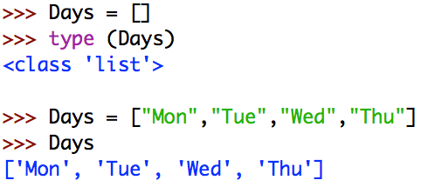
Creating Lists
Empty lists (good for initialisation)
Lists with values

Slide 5
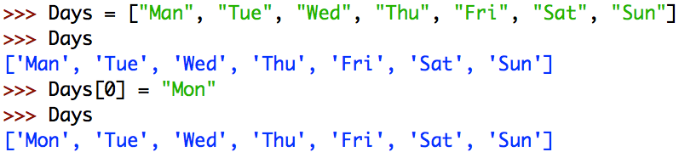

Editing Lists
Items in a list can be accessed using their index.
Beware that indices start in 0, not 1!
Indices : 0 1 2 3 4 5 6

Slide 6
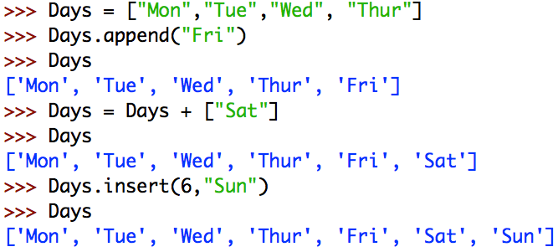

Adding to Lists
List operators to add items to lists
Checking the length of a list

Slide 7
Removing from Lists
Remove: Remove the first matching value from a list
>>> Days = ﻿['Mon', 'Tue', 'Wed', 'Thu', 'Fri', 'Sat']
>>> Days.remove(‘Wed’)
>>> Days
﻿['Mon', 'Tue', 'Thu', 'Fri', 'Sat']
del: Removes item at a specific index
>>> Days = ﻿['Mon', 'Tue', 'Wed', 'Thu', 'Fri', 'Sat']
>>> del Days[1]
['Mon', 'Wed', 'Thu', 'Fri', 'Sat']
pop: Removes item at a specific index and returns it
>>> Days = ﻿['Mon', 'Tue', 'Wed', 'Thu', 'Fri', 'Sat']
>>> thursday = Days.pop(3)
﻿['Mon', 'Tue', 'Thu', 'Fri', 'Sat']
Emptying a list (same as initialising the list)
>>> Days = ﻿['Mon', 'Tue', 'Wed', 'Thu', 'Fri', 'Sat']
>>>Days = []
>>>Days
[]

Slide 8
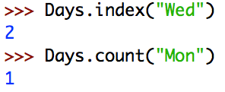
Searching Lists

Slide 9
Editing Lists
Content is edited in-place - lists are mutable!

Slide 10
Strings in Python
Collections
Sequences
Mappings
Immutable
Mutable
dict
str
list
tuple
Strings are immutable, meaning you can’t change their value in-place.

Slide 11

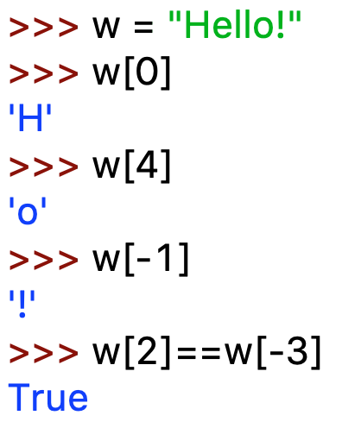
Strings are a sequence of characters.
H
e
l
l
o
!
index
starts at 0!
0
1
2
3
4
5
count backwards
work as well
-6
-5
-4
-3
-2
-1
You can access individual characters:
>>> w[2]==w[-4]
True
Notes:
Remove video where slide wrong and slide fix out of shot

Slide 12
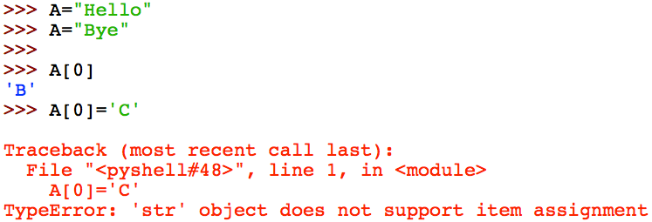
Strings are Immutable
Immutable: can’t change in place!

Slide 13
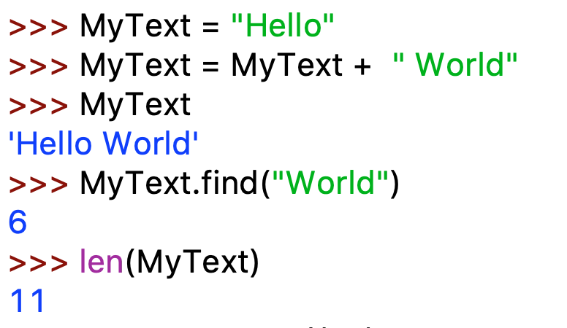
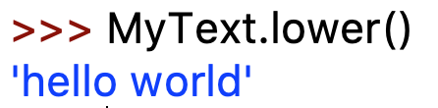


Strings Operators
returns starting
index
returns length of string (spaces count as well)
“dot operator”
to access
more functionality
look up all built
-in functions possible
with strings
help for one specific function,
e.g. what does “join” do

